Slide 1


Machine Learning 5. Model Selection
Xueyuan Gong
School of Intelligent Systems Science and Engineering

Slide 2
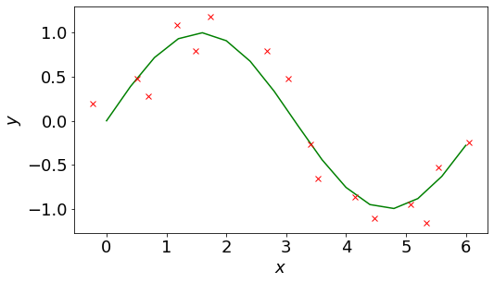
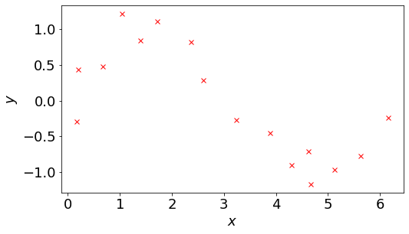
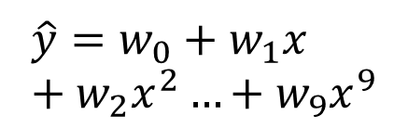
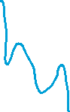
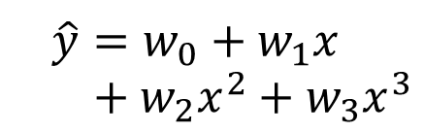
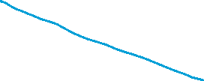

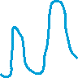
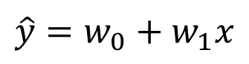
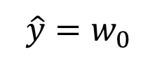
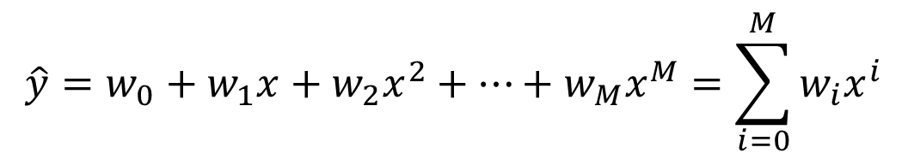
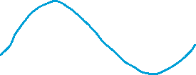
Regression
Suppose our dataset is sampled from
Our model is a polynomial function
$$\hat{y}=w_{0}+w_{1}x+w_{2}x^{2}+…+w_{M}x^{M}=\sum_{i=0}^{M}{w_{i}x^{i}}$$
$$\hat{y}=w_{0}+w_{1}x+w_{2}x^{2}+w_{3}x^{3}$$
$$\hat{y}=w_{0}$$
$$\hat{y}=w_{0}+w_{1}x+w_{2}x^{2}…+w_{9}x^{9}$$
$$\hat{y}=w_{0}+w_{1}x$$

Slide 3
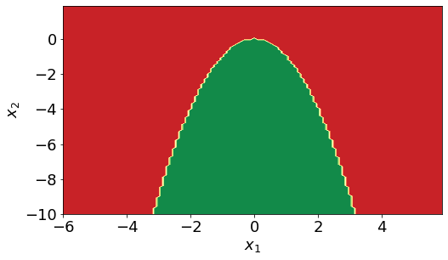
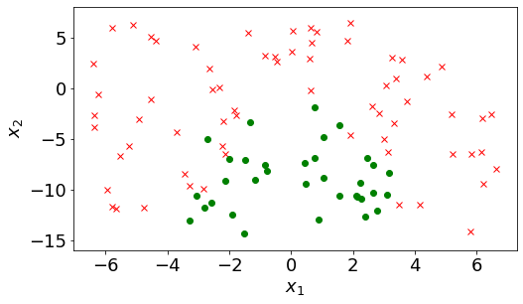

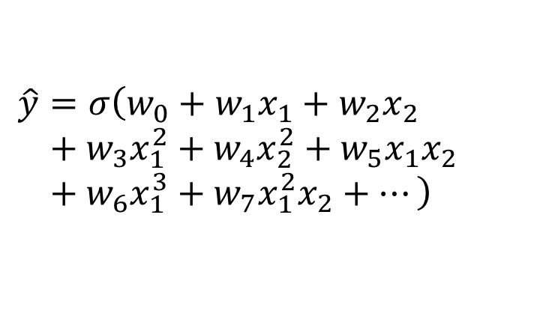
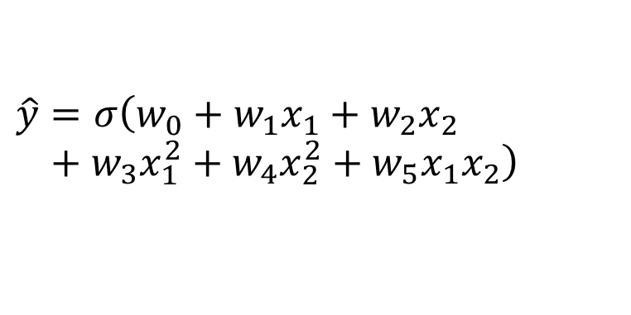
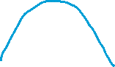
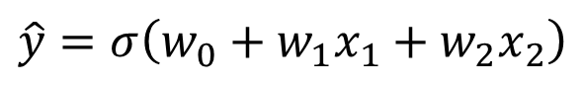
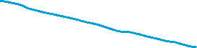
Classification
Suppose our dataset is sampled from
Our model is a polynomial function
$$\hat{y}=σ\left(w_{0}+w_{1}x_{1}+w_{2}x_{2}+w_{3}x_{1}^{2}+w_{4}x_{2}^{2}+…\right)$$
$$\hat{y}=σ\left(w_{0}+w_{1}x_{1}+w_{2}x_{2}\right)$$
$$\hat{y}=σ\left(w_{0}+w_{1}x_{1}+w_{2}x_{2}+w_{3}x_{1}^{2}+w_{4}x_{2}^{2}+w_{5}x_{1}x_{2}\right)$$
$$\hat{y}=σ\left(w_{0}+w_{1}x_{1}+w_{2}x_{2}+w_{3}x_{1}^{2}+w_{4}x_{2}^{2}+w_{5}x_{1}x_{2}+w_{6}x_{1}^{3}+w_{7}x_{1}^{2}x_{2}+…\right)$$

Slide 4
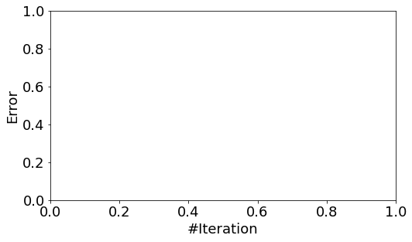

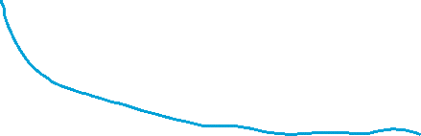
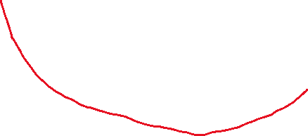
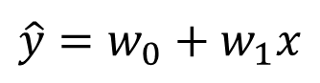
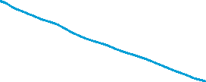
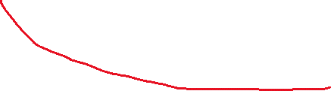
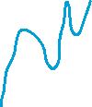
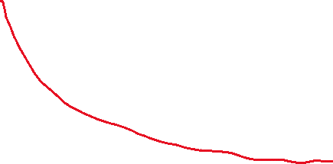
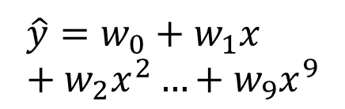
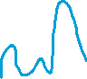
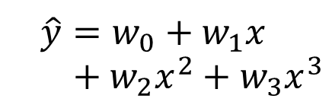
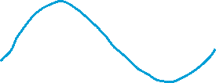
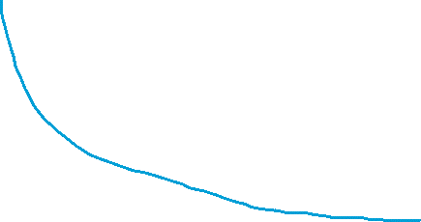
Training and Validation
Good performance on the training set does not necessarily mean the same on the validation set
Underfitting: model is too simple (does not fit the data)
Overfitting: model is too complex (fits perfectly)
Good model: Achieves large validation accuracy (generalizes well)
$$\hat{y}=w_{0}+w_{1}x+w_{2}x^{2}+w_{3}x^{3}$$
$$\hat{y}=w_{0}+w_{1}x+w_{2}x^{2}…+w_{9}x^{9}$$
$$\hat{y}=w_{0}+w_{1}x$$

Slide 5

Data Preparation
It is impossible to know the whole sample space
It is impractical to sample and collect data endlessly
Normally, we collect a dataset with as much data as possible
Cut the dataset into a training set, validation set, and test set
Training set is used for model training
Validation set is used for model selection
Test set is used for pretending to be unseen data (Not a must)
Probably, you will encounter this problem:
Training Set
Validation Set
Test Set
Model 1
Err = 0.5
Err = 0.4
Model 2
Err = 0.2
Err = 0.15
Model 3
Err = 0.1
Err = 0.2

Slide 6
N-fold Cross Validation
Cut the dataset into N segments
Select one segment as validation set each time
Other N-1 segments as training set each time
Dataset
Model 1
Model 2
Model 3
Model 4
3-fold
Cross
Validation
Train
Train
Val
Err = 0.2
Err = 0.4
Err = 0.4
Err = 0.6
Train
Val
Train
Err = 0.4
Err = 0.5
Err = 0.5
Err = 0.7
Val
Train
Train
Err = 0.3
Err = 0.6
Err = 0.3
Err = 0.5
Avg Err
= 0.3
Avg Err
= 0.5
Avg Err
= 0.4
Avg Err
= 0.6
Test Set

Slide 7
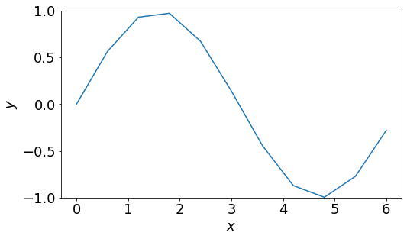
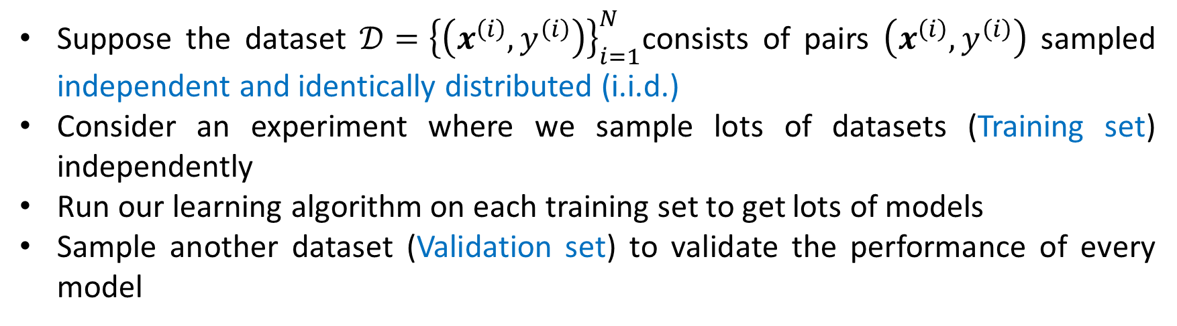
Bias and Variance
Suppose the dataset $𝒟={\left\{\left(x^{\left(i\right)},y^{\left(i\right)}\right)\right\}}_{i=1}^{N}$consists of pairs $\left(x^{\left(i\right)},y^{\left(i\right)}\right)$ sampled independent and identically distributed (i.i.d.)
Consider an experiment where we sample lots of datasets (Training set) independently
Run our learning algorithm on each training set to get lots of models
Sample another dataset (Validation set) to validate the performance of every model
Regression

Slide 8
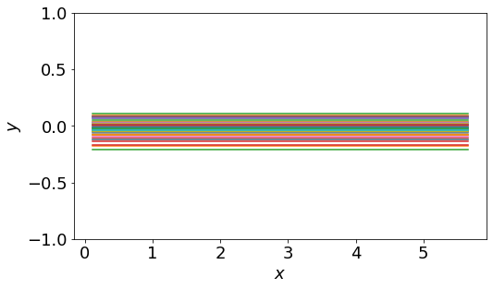
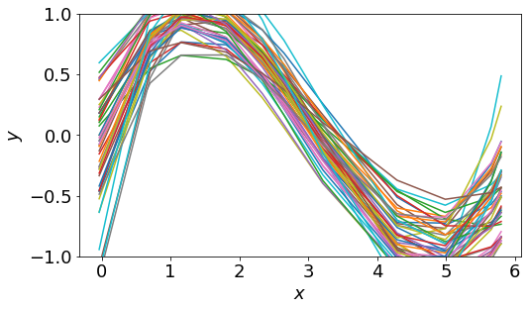
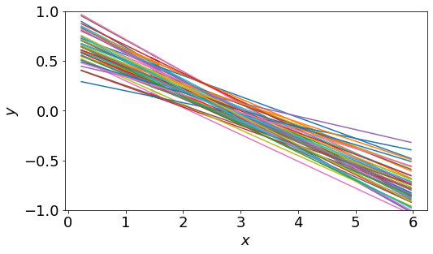
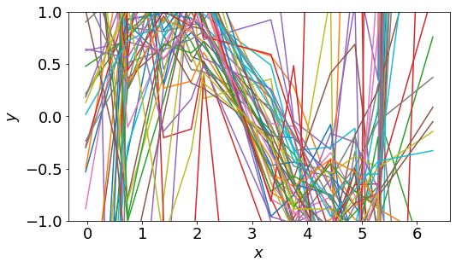
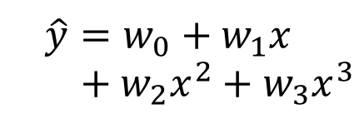
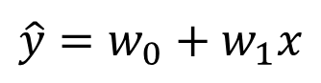
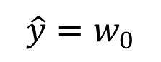
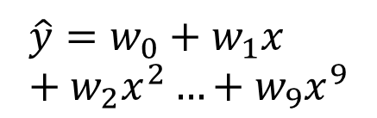
Bias and Variance
Draw all trained models in one figure
As the number of parameters grows, the variance of models increase
$$\hat{y}=w_{0}+w_{1}x+w_{2}x^{2}+w_{3}x^{3}$$
$$\hat{y}=w_{0}$$
$$\hat{y}=w_{0}+w_{1}x+w_{2}x^{2}…+w_{9}x^{9}$$
$$\hat{y}=w_{0}+w_{1}x$$

Slide 9
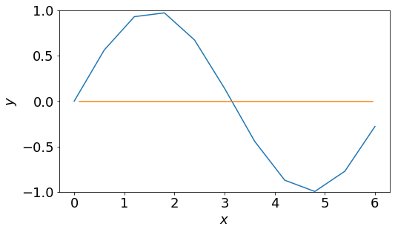
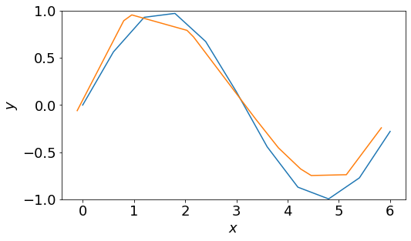
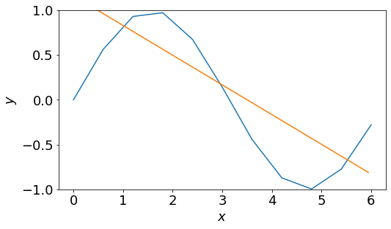
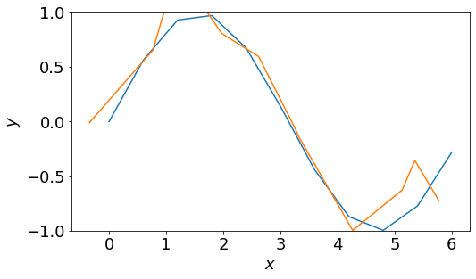
Bias and Variance
Draw the mean model of all models
As the number of parameters grows, the mean of models gets better
$$\hat{y}=w_{0}+w_{1}x+w_{2}x^{2}+w_{3}x^{3}$$
$$\hat{y}=w_{0}$$
$$\hat{y}=w_{0}+w_{1}x+w_{2}x^{2}…+w_{9}x^{9}$$
$$\hat{y}=w_{0}+w_{1}x$$

Slide 10
Bias and Variance
Draw the performance of every model on validation set in the parameter space
Bias: how wrong the expected prediction is (corresponds to underfitting)
Variance: the amount of variability in the predictions (corresponds to overfitting)
Throwing darts = predictions for each draw of a dataset
There is always a trade-off between bias and variance

Slide 11
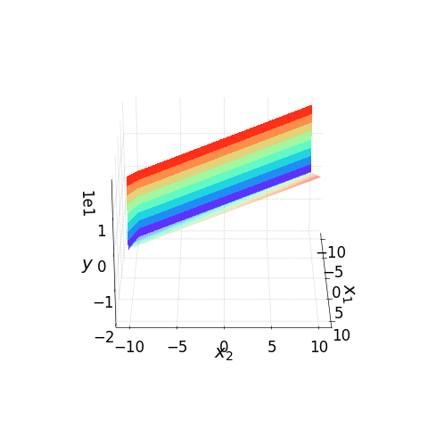
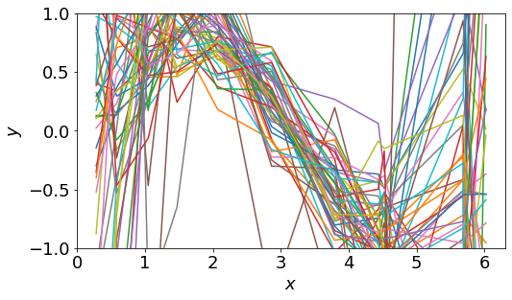
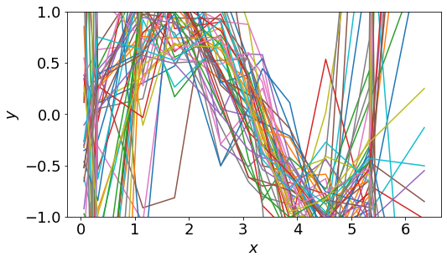
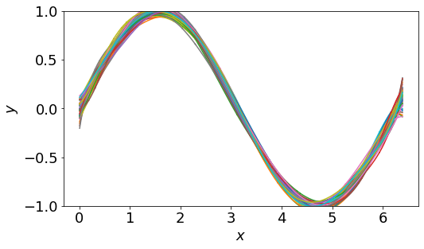
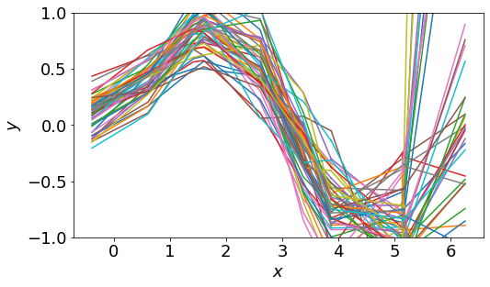

Solve Problems in your ML Task
Underfitting (Large bias)
A more complex model
Add more features as input
Overfitting (Large variance)
Collect more data
A simpler model
Regularization $⇒$ May increase bias

Slide 12
Thank you！

